Slide 1

Abstract data Structure
LINKED LIST

Slide 2

Objectives
Students should be able to
Understand the concept of linked lists and their advantages over arrays.
Learn about the basic terminology associated with linked lists.

Slide 3

Linked List
A linked list is a linear data structure in which elements are stored in nodes, and each node points to the next node in the sequence.
It is a dynamic data structure, which means that the size of the list can change at run time.
It is like a chain where each link is connected to the next one to form a sequence with a start and an end.

Slide 4
Linked list
In a linear list, the list items are stored in consecutive locations. This is not always appropriate.
Another method is to store an individual list item in whatever location is available and link the individual item into an ordered sequence using pointers.
An element of a linked list is called a node.
A node can consist of several data items and a pointer, which is a variable that stores the address of the node it points to.
A pointer that does not point at anything is called a null pointer. It is usually represented by ∅. A variable that stores the address of the first element is called a start pointer.

Slide 5
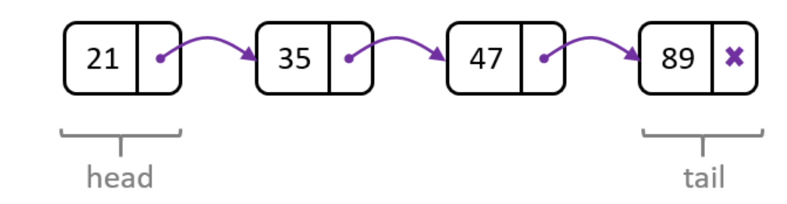
Linked list
Each element in a linked list is called a node. Each node stores:
The data relating to the element
A pointer to the next node
The first node of the list is called the head, and the last node is the tail.

Slide 6
Linked list
The data value in the node box represents the key field of that node. There are likely to be many data items associated with each node.
The arrows represent the pointers.
It does not show at which address a node is stored, so the diagram does not give the value of the pointer, only where it conceptually links to.

Slide 7
There are three Primary Insertion Operations
Insert at the beginning of the list.
Insert at the end of the list.
Insert after a given node.

Slide 8
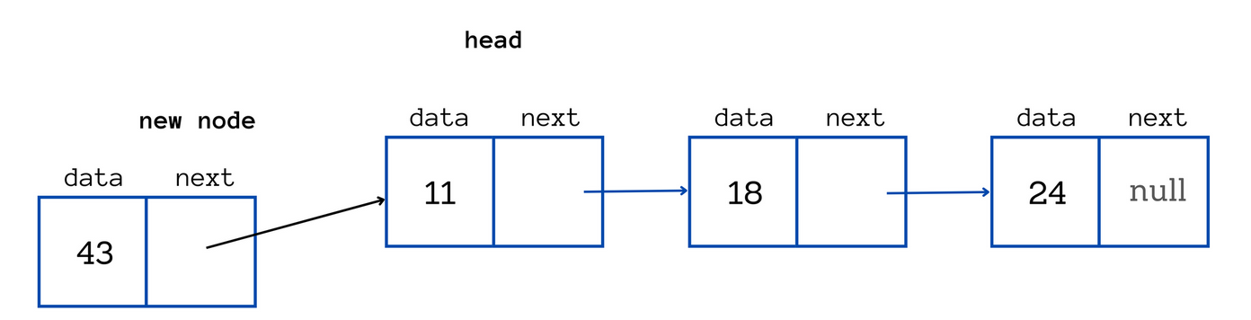
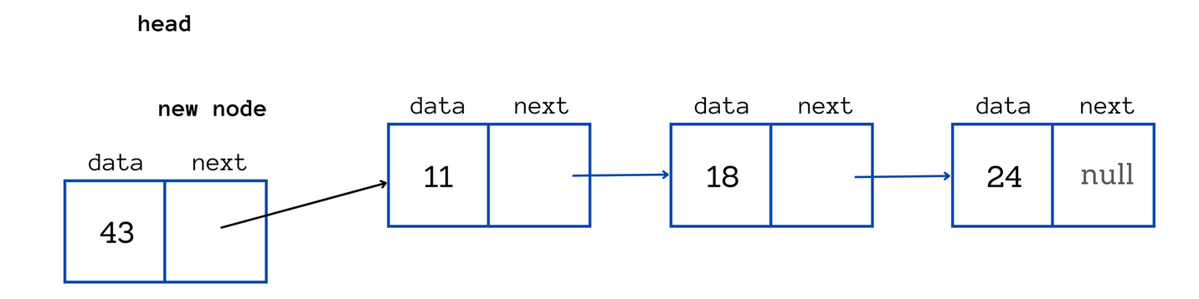
Insert at the beginning
Given list is 2 → 3, and we have to insert 1 at the front of the list. So, to insert 1 at front, we will simply make 1’s next point to 2 and make 1 as the new head of the linked list and our final linked list will be: 1 → 2 → 3.
The new node which gets added at the front of the list, will be the new head of the list.

Slide 9
Insert at the beginning
Algorithm
1) Create the node which is to be inserted, say newnode.
2) If the list is empty, the head will point to the newnode, and we will return.
3) Else, If the list is not empty:
Make newnode → next = head. This step ensures that the new node is being added at the beginning of the list.
Then after that, make head = newnode, as the new node is now the first node of the list, hence the new head

Slide 10
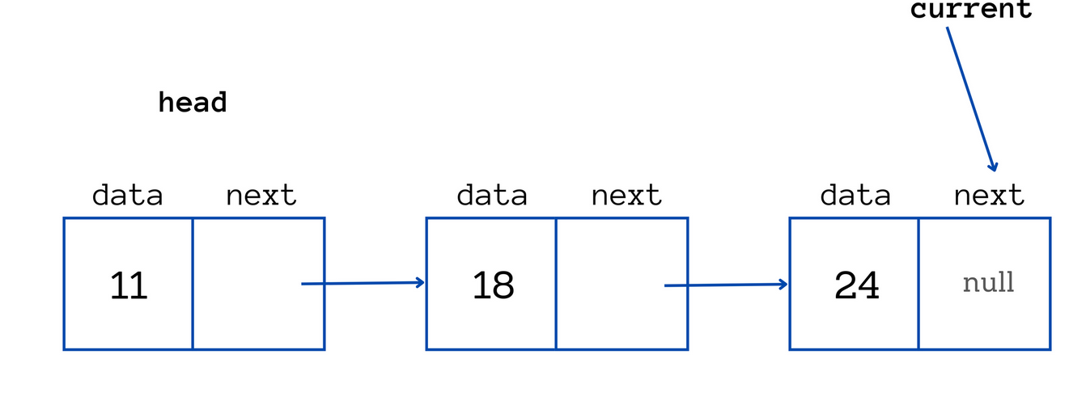
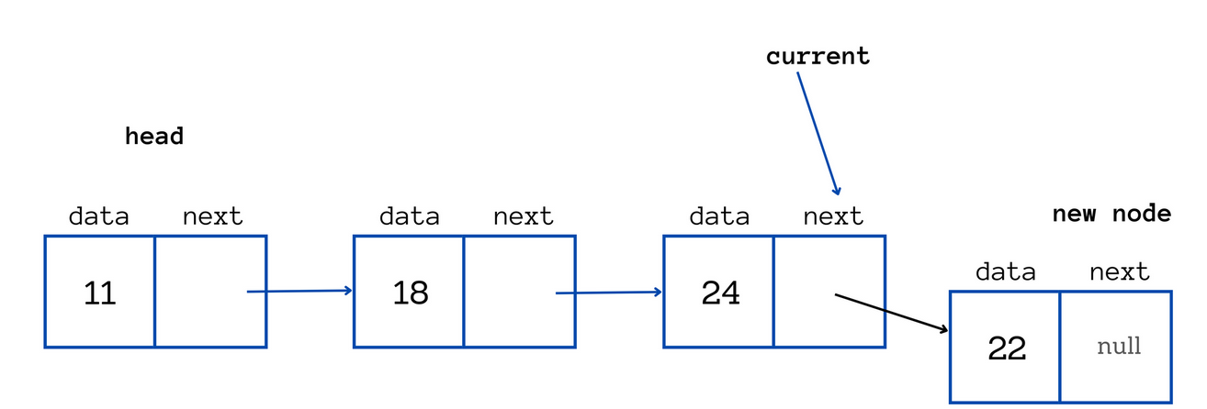
Insert at the end
The list is 1 → 2 →3, and we have to add 4 at the end of this list.
A connection has to be made between 3 and 4, and then, make the next of 4 as null as it is the new last node.

Slide 11
Insert at the end
The list is 1 → 2 →3, and we have to add 4 at the end of this list.
A connection has to be made between 3 and 4, and then, make the next of 4 as null as it is the new last node.

Slide 12
Insert at the inside the list
Algorithm
1) Create the node which is to be inserted, say newnode.
2) If the list is empty, make head point to the newnode, and return.
3) Else, if the list is not empty:
Using a pointer curr, traverse the list up to the last node of the list.
After the traversal, curr will be standing at the last node, and now, to insert the newnode at the end of the list, make curr → next = newnode and then newnode → next = NULL, as newnode is the new last node of the linked list

Slide 13
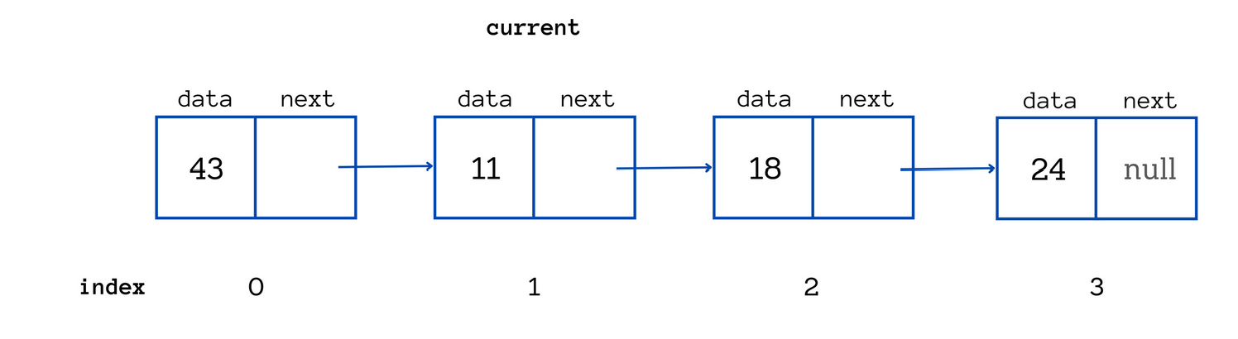
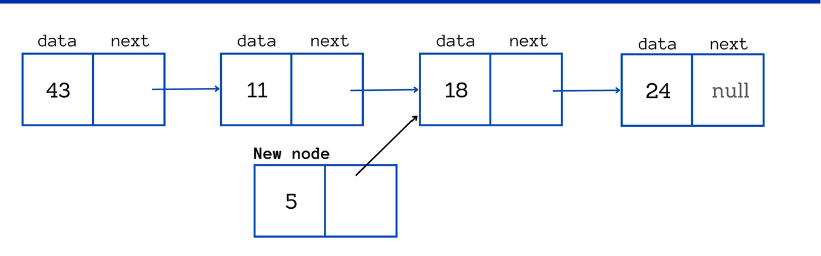
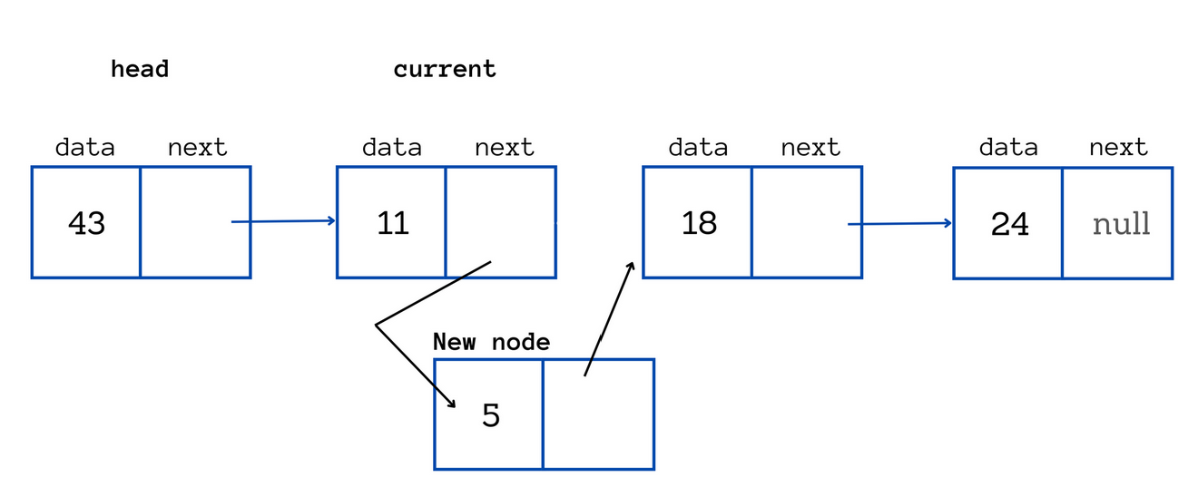
Insert at the inside the list
Given list is: 1 → 2 → 3, and we have the address of 2, and we want to insert a new node (say x) after node 2.
do x → next = 2 → next and then 2 → next = x.
By doing x → next = 2 → next, we are making sure that x is being inserted after 2, and by doing 2 → next = x, we are again making sure that the links are complete.
First, we will make newnode → next = NODE → next
Then, we will make NODE → next = newnode

Slide 14
Deleting a node in a linked list
There are two ways to delete nodes in a linked list:
Deleting the head node.
Deleting a node at a given position.

Slide 15
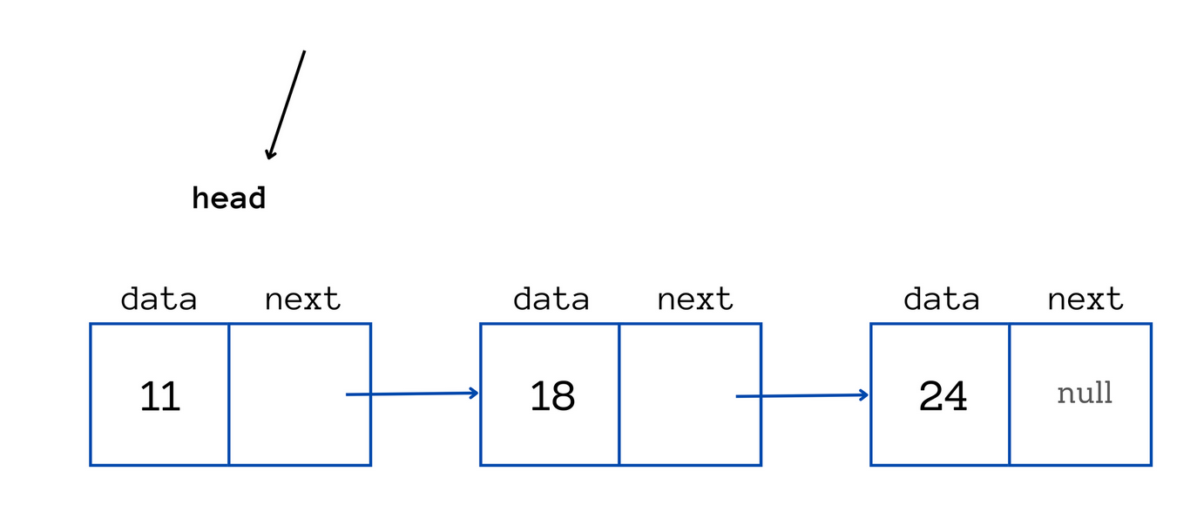
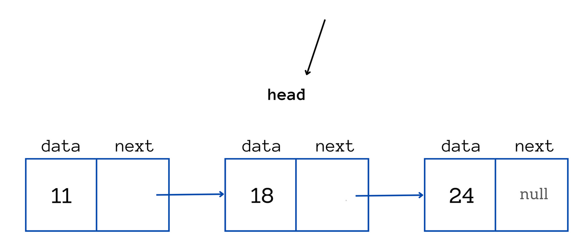
How to delete the head node
You can store the data of the head node in a temporary variable if it needs to be accessed later.
Then set the head pointer to point to the next node after the head node.

Slide 16
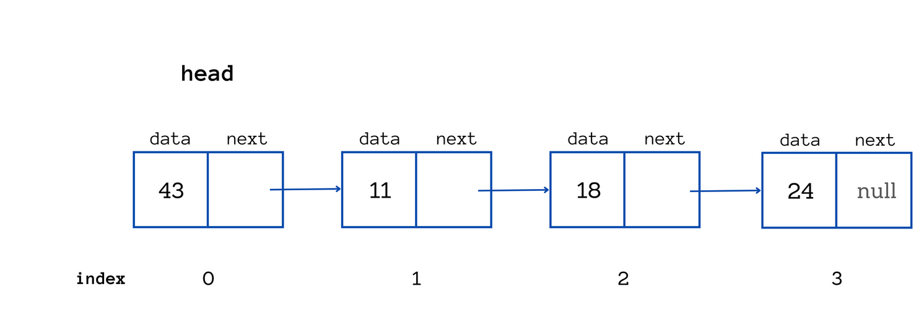
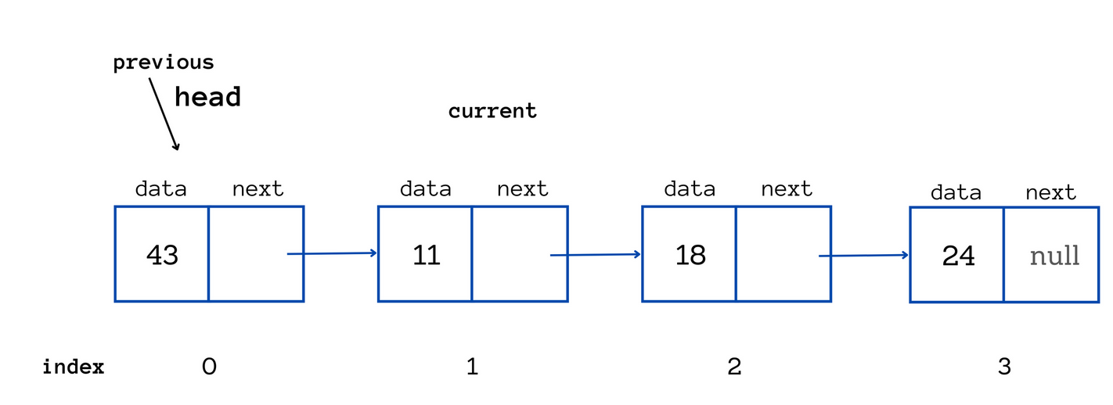
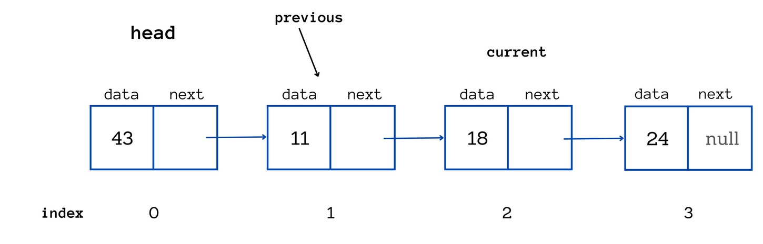
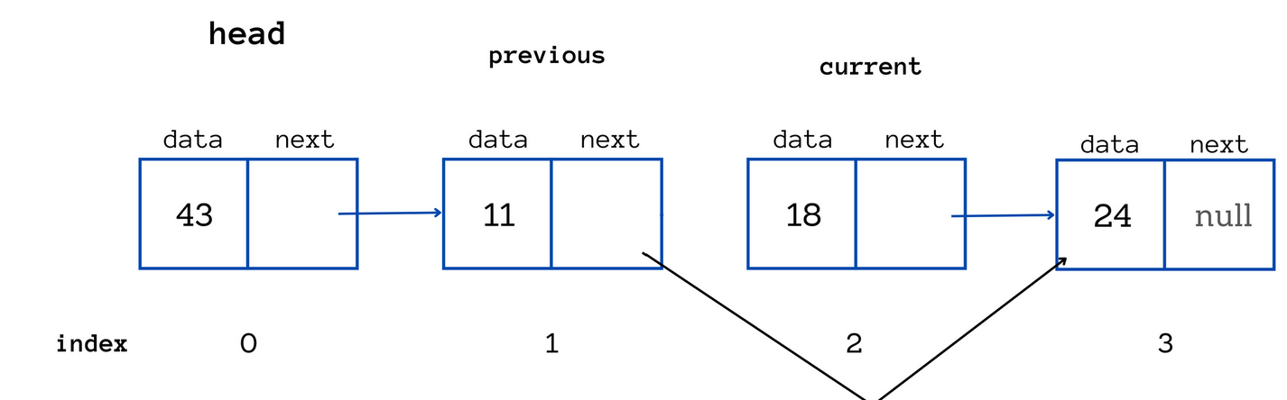
Deleting a Node at a given position
To delete the node at index 2 (note with data 11)
by making the node at index 1 point to the node at index 3.
Access the node you want to delete and the node before it.
Take two temporary pointers (you can call the pointers previous and current).
Let previous point to null and current point to the head node.
Now, move current one step forward and move previous to current till you reach index 2.
Make the next of previous point to the next of the current node.
Then store the data of current in a variable for future use.

Slide 17
Deleting a node at a given position
Then store the data of current in a variable for future use.
After removing the link to the node at index 2, it is no longer accessible through any reference in the linked list.
It's important to note that when removing a node from a linked list, you don't need to explicitly delete the node itself at the given index. This is because the removed node will be automatically handled by the garbage collector when it is no longer reachable through any references.

Slide 18
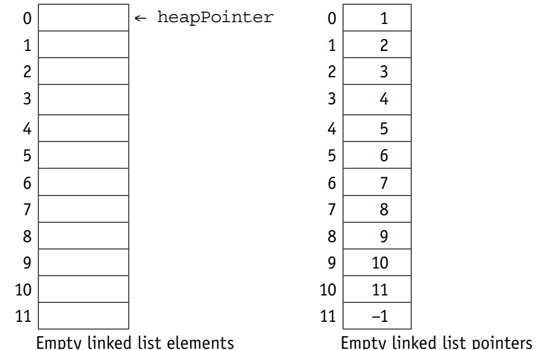
Implementation
A linked list can be implemented using two 1D arrays, one for the items in the linked list and another for the pointers to the next item in the list, and a set of pointers.
As an array has a finite size, the linked list may become full and this condition must be allowed for. Also, as items can be removed from any position in the linked list, the empty positions in the array must be managed as an
empty linked list, usually called the heap.
The following diagrams demonstrate the operations of linked lists
The startPointer = –1, as the list has no elements. The heap is set up as a linked list ready for use.

Slide 19
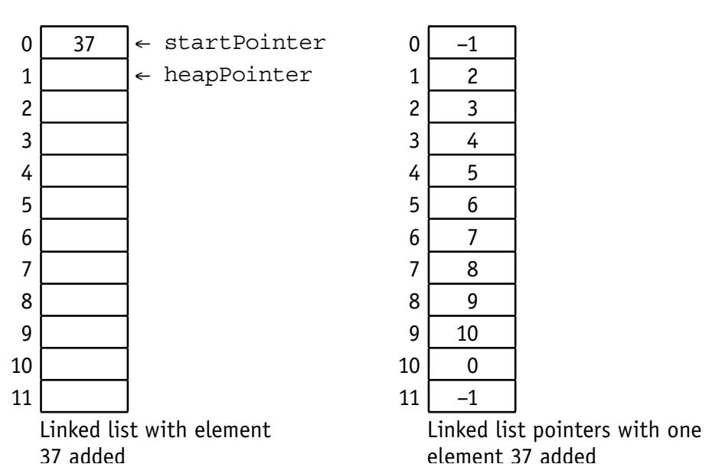
Implementation
The startPointer is set to the element pointed to by the heapPointer where 37 is inserted.
The heapPointer is set to point to the next element in the heap by using the value stored in the element with the same index in the pointer list.
Since this is also the last element in the list the node pointer for it is reset to –1.

Slide 20
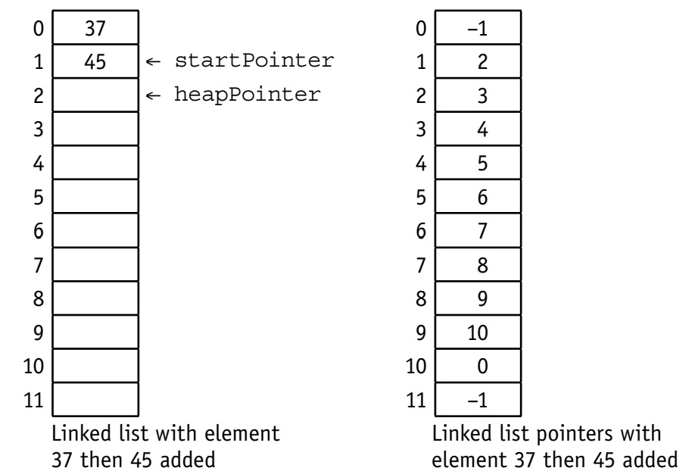
Implementation
The startPointer is changed to the heapPointer and 45 is stored in the element indexed by the heapPointer.
The node pointer for this element is set to the old startPointer.
The node pointer for the heapPointer is reset to point to the next element in the heap by using the value stored in the element with the same index in the pointer list.

Slide 21
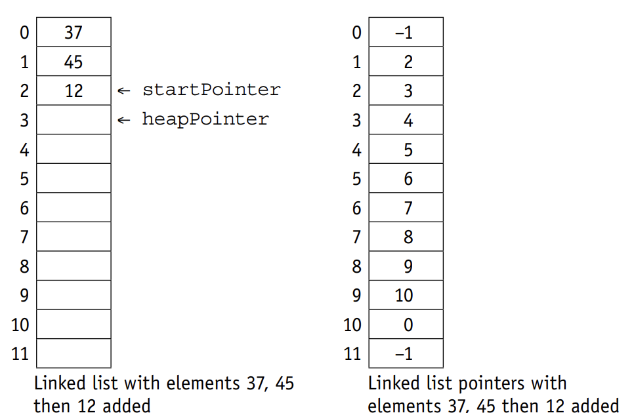
Implementation
The process is repeated when 12 is added to the list.

Slide 22
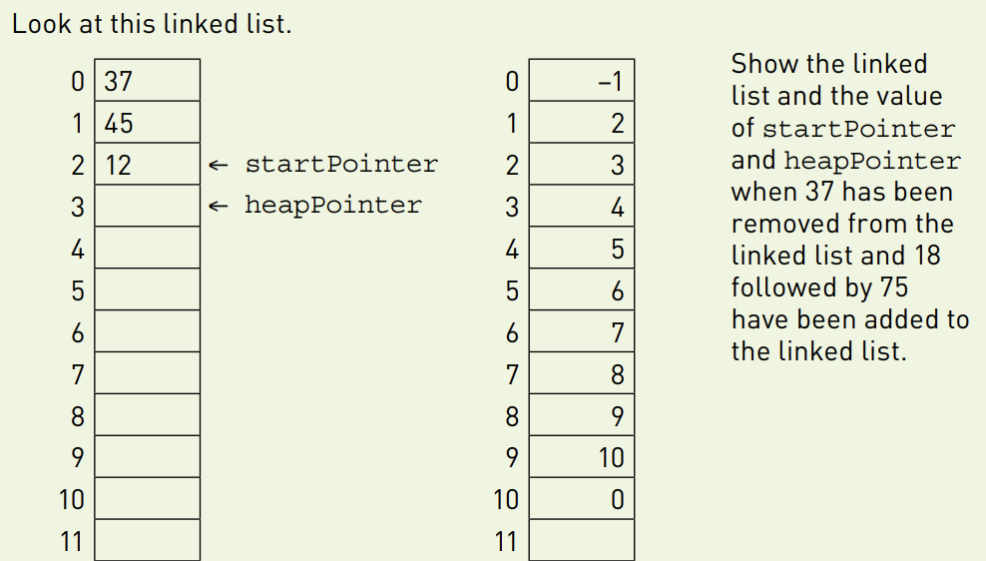
ACTIVITY

Slide 23
ACTIVITY
A coach company offers tours of the UK.
A linked list stores the names of cities on a coach tour in the order they are visited.
Describe what is meant by the term ‘linked list
The tour is amended. The new itinerary is: London, Oxford, Manchester then York. Explain how Birmingham is removed from the linked list and how York is added. You may use the diagram below to illustrate your answer.

Slide 24
Linked List Operation
Insert
Delete item in a linked list
Search Item in a linked list

Slide 25
Linked List Operation
# Search for the node to be deleted
prev_node = None
while current_node and current_node.data != key:
prev_node = current_node
current_node = current_node.next
# If the node is not present
if current_node is None:
print(f"Node with key {key} not found.")
return
# Unlink the node from the linked list
prev_node.next = current_node.next
current_node = None
def print_list(self):
current_node = self.head
while current_node:
print(current_node.data, end=" -> ")
current_node = current_node.next
print("None")
class Node:
def __init__(self, data):
self.data = data
self.next = None
class LinkedList:
def __init__(self):
self.head = None
def delete_node(self, key):
current_node = self.head
# If the node to be deleted is the head
if current_node and current_node.data == key:
self.head = current_node.next
current_node = None
return

Slide 26
Insert a node- Python
class Node:
def __init__(self, data):
self.data = data
self.next = None
class LinkedList:
def __init__(self):
self.head = None
def insert_at_beginning(self, data):
new_node = Node(data)
new_node.next = self.head
self.head = new_node
def insert_at_end(self, data):
new_node = Node(data)
if not self.head:
self.head = new_node
return
last_node = self.head
while last_node.next:
last_node = last_node.next
last_node.next = new_node
def insert_after_node(self, prev_node, data):
if not prev_node:
print("Previous node is not in the list.")
return
new_node = Node(data)
new_node.next = prev_node.next
prev_node.next = new_node
def print_list(self):
current_node = self.head
while current_node:
print(current_node.data, end=" -> ")
current_node = current_node.next
print("None")
Example Usage:
linked_list = LinkedList()
# Insert at the beginning
linked_list.insert_at_beginning(3)
linked_list.insert_at_beginning(2)
linked_list.insert_at_beginning(1)
# Insert at the end
linked_list.insert_at_end(4)
linked_list.insert_at_end(5)
# Insert after a specific node
second_node = linked_list.head.next
linked_list.insert_after_node(second_node, 2.5)
# Print the linked list
linked_list.print_list()

Slide 27
Search for a node- Python
class Node:
def __init__(self, data):
self.data = data
self.next = None
class LinkedList:
def __init__(self):
self.head = None
def search_node(self, target_data):
current_node = self.head
index = 0
while current_node:
if current_node.data == target_data:
return index
current_node = current_node.next
index += 1
# If the target data is not found
return -1
def print_list(self):
current_node = self.head
while current_node:
print(current_node.data, end=" -> ")
current_node = current_node.next
print("None")

Slide 28
Thank You

